Slide 1
Microservices
Building Blocks for Microservices

Slide 2
Content
Monolithic vs. Microservices
Microservices pro and cons
Design Pattern and Concepts
Reactivo Manifesto
Reactive microservices
Lambda architecture
SMACK stack
Microservice frameworks

Slide 3
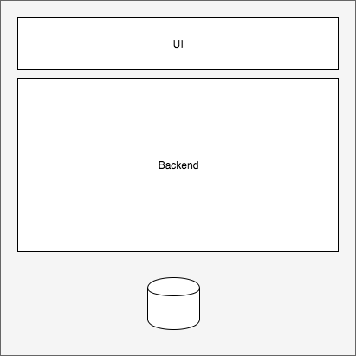
Monolithic vs. Microservices
Most of the time just one
huge project with one data source
for all logic
Scala out in monolith systems is hard and often not possible

Slide 4
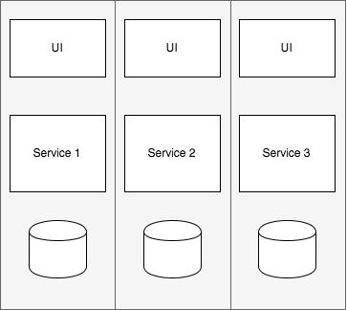
Monolithic vs. Microservices
Services are sliced into small parts
Every service should use its own
data source
Microservices are much more complex, but you can easily scale up and out.
You need a high automation level
➔Microservices are NOT a Silver Bullet

Slide 5
Microservices pro and cons
Pro
scalable (up & out)
replaceability
inhomogeneous techstack
bounded context
loosely coupled
Independent services & teams
fast deployment and roll out
caching
highly automated
Con
Good operation is hard
Monitoring
Logging
Deployment
Cluster-Setup
Storage
Backup
Recovery
tech stack
cascading failures
latency
Notes:
Skalierbarkeit
Austauschbarkeit
Inhomogene Technologien möglich
Verstärkt Modularität
Unabhängigkeit zwischen Services
Unabhängigkeit zwischen Teams
Schnelleres Deployment

Slide 6
Design Pattern and Concepts DDD – Domain Driven Design
Define services corresponding to
Domain-Driven Design (DDD) subdomains.
DDD refers to the application’s problem
space as the domain.
A domain is consists of multiple
subdomains. Each subdomain
corresponds to a different part
of the business.
➔ http://microservices.io/patterns/decomposition/decompose-by-subdomain.html

Slide 7
Design Pattern and Concepts Scale Up & Scale Out
https://turbonomic.com/blog/on-turbonomic/to-scale-up-or-scale-out-that-is-the-question/

Slide 8
Design Pattern and Concepts Event Driven
flow of the program is determined by events
Needed for data exchange between different services in a cluster
A lot of programming languages use the actor pattern. akka is one implementation for scala and java
In lesson “Data Persistence” we will look at Event Sourcing and CQRS.
Service 2
Service 3
EVENT BUS
Service 1
Service 4

Slide 9
Design Pattern and Concepts The Actor Model
An actor is the primitive unit of computation.
similar to object-oriented languages:
An object receives a message (a method call)
do something depending on which message it receives (which method)
difference is that actors are completely isolated from each other and they will never share memory
Although multiple actors can run at the same time, an actor will process a given message sequentially.
Messages are sent asynchronously to an actor. The mailbox is the place where these messages are stored.
When an actor receives a message, it can do one of these 3 things:
Create more actors;
Send messages to other actors;
Designates what to do with the next message.
http://www.brianstorti.com/the-actor-model/

Slide 10
Design Pattern and Concepts The Actor Model
Actors communicate with each other by sending asynchronous messages.
Those messages are stored in other actors' mailboxes until they're processed.

Slide 11
Reactivo Manifesto
https://www.reactivemanifesto.org/
http://markusjura.github.io/reactive-with-java8/assets/reactive-manifesto.png

Slide 12
Design Pattern and Concepts Load Balancer
How does the client of a service - the API gateway or another service - discover the location of a service instance?
https://cdn.wp.nginx.com/wp-content/uploads/2016/04/Richardson-microservices-part4-3_server-side-pattern.png
http://microservices.io/patterns/server-side-discovery.html

Slide 13
Design Pattern and Concepts Circuit Braker
How to prevent a network or service failure from cascading to other services?
A service client should invoke a remote service via a proxy that functions in a similar fashion to an electrical circuit breaker.
https://d3ansictanv2wj.cloudfront.net/mapr_0203-f6181a9a1ef2e1cf22272aa45b15c0fd.png
http://microservices.io/patterns/reliability/circuit-breaker.html

Slide 14
Lambda architecture
The LA aims to satisfy the needs for a robust system that is fault-tolerant, both against hardware failures and human mistakes, being able to serve a wide range of workloads and use cases, and in which low-latency reads and updates are required. The resulting system should be linearly scalable, and it should scale out rather than up.

Slide 15
Lambda architecture

Slide 16
Lambda architecture
All data entering the system is dispatched to both the batch layer and the speed layer for processing.
The batch layer has two functions: (i) managing the master dataset (an immutable, append-only set of raw data), and (ii) to pre-compute the batch views.
The serving layer indexes the batch views so that they can be queried in low-latency, ad-hoc way.
The speed layer compensates for the high latency of updates to the serving layer and deals with recent data only.
Any incoming query can be answered by merging results from batch views and real-time views.
➔ http://lambda-architecture.net/

Slide 17
SMACK Stack
De facto Stack for Big-Data (Microservices)
Apache Spark S
Apache Mesos M
Akka A
Apache Cassandra C
Apache Kafka K
More Big-Data, Smack, Lambda in Lesson 11

Slide 18
Microservice Frameworks
Java/Scala/Kotlin/… (JVM)
Akka Cluster
Lagom
Vert.x
Spring Boot
Payara Micro
Wildfly Swarm
.NET (Core)
ASP.NET Core
Nancy
Auch für viele andere Sprachen/Umgebungen vorhanden (Go, Node.js, PHP, Python…)

Slide 19
Microservice Frameworks
Lesson 1.3
Your results will be added here

